Slide 1
Yoga Posture Detection and Estimation
Karthik raja, APRIL 9TH, 2024
EMGT 5220
INSTRUCTOR: Professor George kontopidis

Slide 2
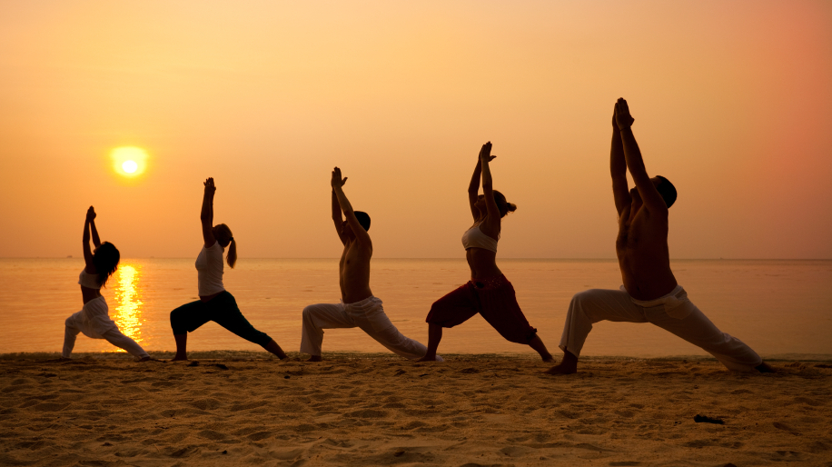
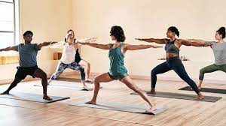
Yoga Practice imperfection
PROBLEM STATEMENT

Slide 3
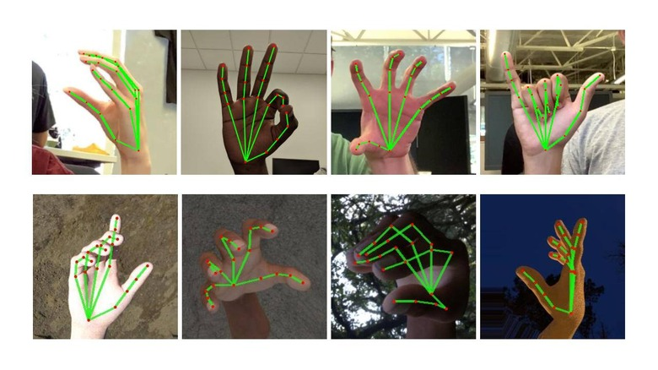
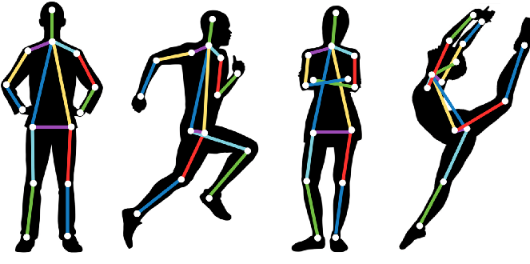
SCOPE
Capture body key points
Audio, Text Feedback
Track progress
Video Demonstration

Slide 4
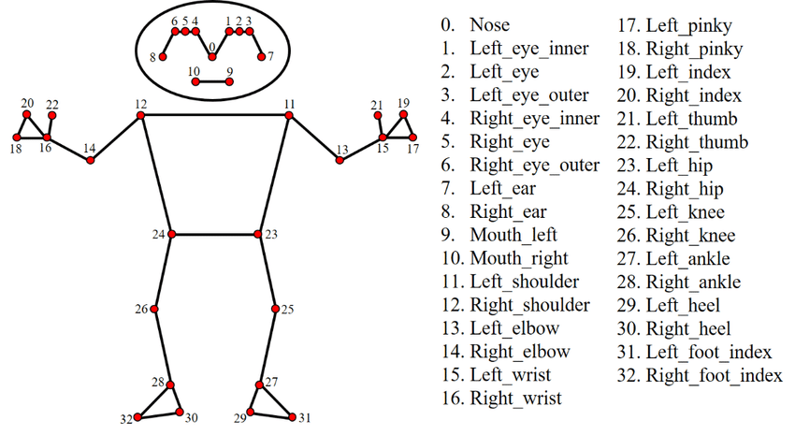
KEYPOINTS DETECTION USING MEDIAPIPE

Slide 5
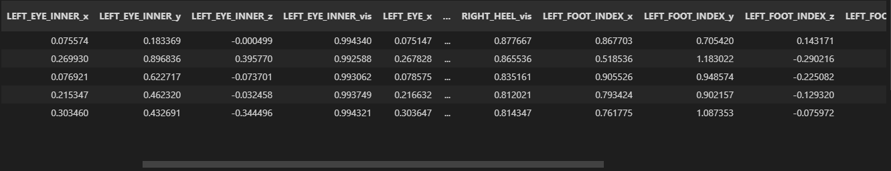
METHODS
The proposed methodology revolves around the application of cutting-edge deep learning techniques to detect and estimate a wide spectrum of yoga poses. Through the integration of these advanced algorithms, this research aims to ensure that the right muscles are engaged, and the ideal postures are achieved.
Feature Extraction

Slide 7
CLASSIFICATION
SVM
CNN
RCNN and LSTM

Slide 8
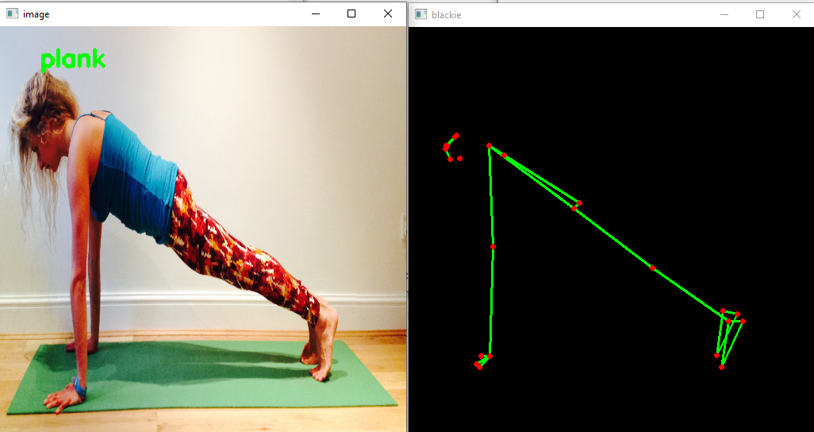
RESULTS
The present study used deep learning architecture Mediapipe for pose estimation to evaluate yoga postures, and the results support the fact that MediaPipe provides accuracy using a single camera. The inaccurate body pose of the user can be pointed out in real time, so that the user can rectify the mistakes.

Slide 9
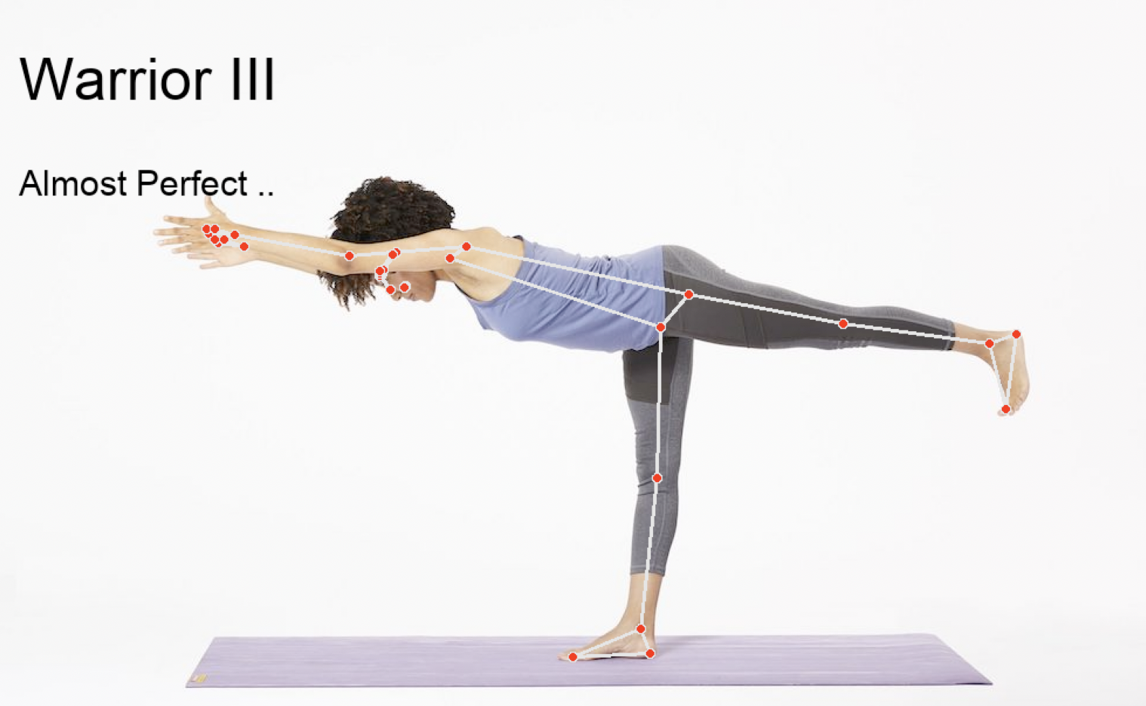
FUTURE WORKS
Moving from 2D to 3D image recognition for in-depth muscle movement recognition

Slide 10
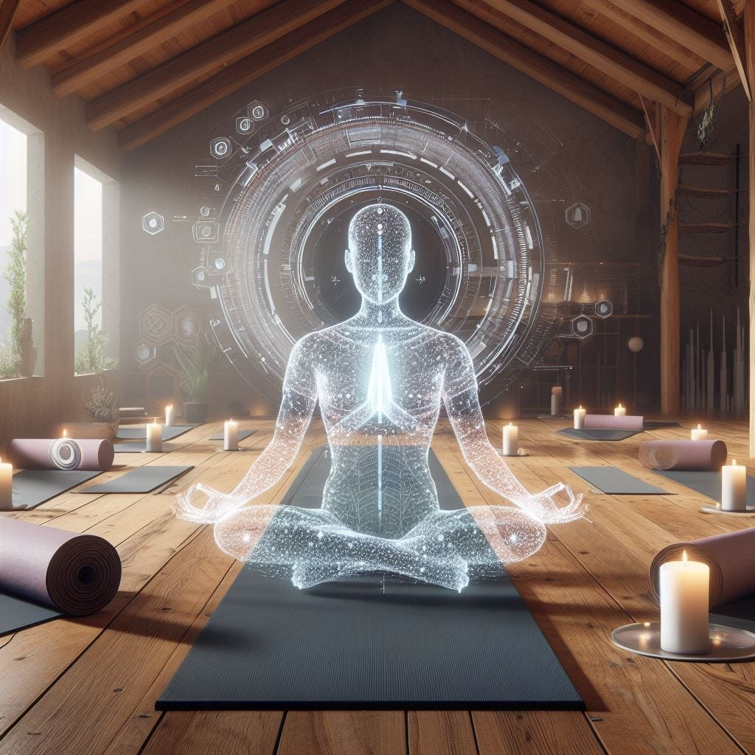

Slide 11


Thank You

